Slide 1

PowerShell System Utilities
Adam Driscoll
Adam Driscoll
Twitter: @adamdriscoll
adriscoll@concurrency.com
Senior Application Developer

Slide 2
Agenda
File System Tools
Registry Tools
Data Manipulation
COM Interop
WMI
Event Logs
Lab

Slide 3
Working with files
Working with File Contents
Managing the file system
Managing ACLs

Slide 4
Working with File Contents
Get-Content
Reads file contents
Can read line-by-line or whole file
Can trail files
Out-File
Writes to files
Accepts pipeline input

Slide 5
Managing the file system
Uses standard *Item cmdlets
Aliases for many commands that match the cmd and bash shells
New drives can be created for shares or other file paths

Slide 6
Managing ACLs
Get-Acl – Returns ACL for a particular item path
Set-Acl – Sets the ACL for a particular item path
CALCS Might be easier to use in some circumstances
Notes:
.\Start-Demo.ps1 .\Files.ps1

Slide 7
Registry Tools
Create, read, update and delete registry keys and values
Drives for each one of the registry hives
Uses the standard Item* cmdlets
Utilize .NET to access remote registries
Notes:
.\Start-Demo.ps1 .\Registry.ps1

Slide 8
Data Manipulation
Import-CSV, Export-CSV
[Xml]
ConvertFrom-Json, ConvertTo-Json
Notes:
ISE .\DataManipulation.ps1

Slide 9
Component Object Model (COM) Interop
Access COM objects via New-Object
Interact with applications like Excel, Word and Internet Explorer
Requires architecture specific COM service

Slide 10
Windows Management Instrumentation (WMI)
Windows Management Instrumentation (WMI) is the Microsoft implementation of Web-Based Enterprise Management (WBEM), which is an industry initiative to develop a standard technology for accessing management information in an enterprise environment.
Implemented in NT 4.0 and available in Windows since
Manage machines without PowerShell
Manage non-windows devices via the CIM interface
Basis for many modules built in Windows modules (CD1XML)
https://msdn.microsoft.com/en-us/library/windows/desktop/aa384642(v=vs.85).aspx

Slide 11
Examples of WMI\CIM Classes
Win32_Process
Win32_OperatingSystem
Win32_Fan
Win32_PointingDevice
Win32_LoggedOnUser
Win32_SystemBIOS
CIM_DataFile

Slide 12
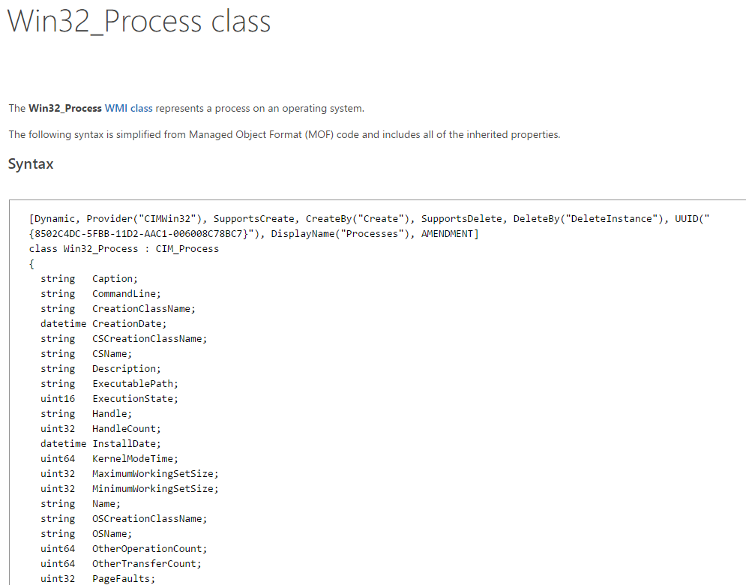

Slide 13
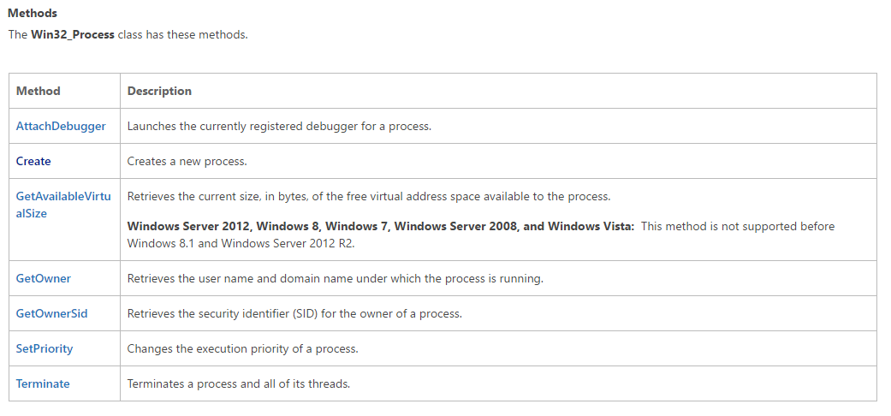

Slide 14
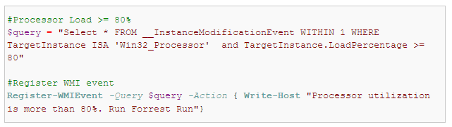
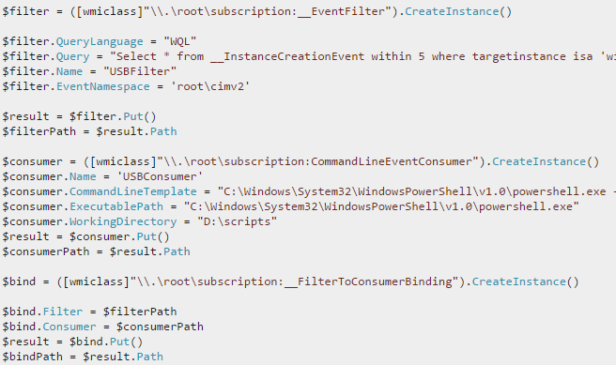
WMI Events
Local Events Subscription
Permanent Events Subscription
http://stackoverflow.com/questions/27107902/permanent-wmi-event-consumer-doesnt-get-triggered-temporary-does
https://www.simple-talk.com/sql/database-administration/using-powershell-and-wmi-events-queries-for-powerful-notifications/
Notes:
.\Start-Demo.ps1 .\Wmi.ps1

Slide 15
Event Logs
Read local and remote event log entries
Create new event log sources
Write to the event log
Notes:
.\Start-Demo.ps1 .\EventLog.ps1 (requires admin)

Slide 16
Lab
Get a list of files, recursively, in the Program Files folder and list out the file name applied ACL for that file. Output as a CSV
Start Internet Explorer, navigate to News.Ycombinator.com and output the top 10 links and addresses to the console.
Output the following information about your machine
System Up Time
Processor Type
Sound Device Manufacturer
Number of threads on your system
Create a new event log source and write an error and an info message to the log.

